Slide 1
Artificial Intelligence Chapter 3: Solving Problems by Searching

Slide 2
Problem Solving Agents
Problem solving agent
A kind of “goal based” agent
Finds sequences of actions that lead to desirable states.
The algorithms are uninformed
No extra information about the problem other than the definition
No extra information
No heuristics (rules)

Slide 3
Goal Based Agent
Goal Based Agent
What the world
is like now
Sensors
Percepts
State
How the world evolves
What my actions do
Environment
What it will be like
if I do action A
Goals
What action I
should do now
Actions
Actuators

Slide 4
Goal Based Agent
Function Simple-Problem-Solving-Agent( percept ) returns action
Inputs: percept a percept
Static: seq an action sequence initially empty
state some description of the current world
goal a goal, initially null
problem a problem formulation
state <- UPDATE-STATE( state, percept )
if seq is empty then do
goal <- FORMULATE-GOAL( state )
problem <- FORMULATE-PROBLEM( state, goal )
seq <- SEARCH( problem ) # SEARCH
action <- RECOMMENDATION ( seq ) # SOLUTION
seq <- REMAINDER( seq )
return action # EXECUTION

Slide 5
Goal Based Agents
Assumes the problem environment is:
Static
The plan remains the same
Observable
Agent knows the initial state
Discrete
Agent can enumerate the choices
Deterministic
Agent can plan a sequence of actions such that each will lead to an intermediate state
The agent carries out its plans with its eyes closed
Certain of what’s going on
Open loop system

Slide 6
Well Defined Problems and Solutions
A problem
Initial state
Actions and Successor Function
Goal test
Path cost

Slide 7
Example: Water Pouring
Given a 4 gallon bucket and a 3 gallon bucket, how can we measure exactly 2 gallons into one bucket?
There are no markings on the bucket
You must fill each bucket completely

Slide 8
Example: Water Pouring
Initial state:
The buckets are empty
Represented by the tuple ( 0 0 )
Goal state:
One of the buckets has two gallons of water in it
Represented by either ( x 2 ) or ( 2 x )
Path cost:
1 per unit step

Slide 9
Example: Water Pouring
Actions and Successor Function
Fill a bucket
(x y) -> (3 y)
(x y) -> (x 4)
Empty a bucket
(x y) -> (0 y)
(x y) -> (x 0)
Pour contents of one bucket into another
(x y) -> (0 x+y) or (x+y-4, 4)
(x y) -> (x+y 0) or (3, x+y-3)

Slide 10
Example: Water Pouring

Slide 11
Example: Eight Puzzle
States:
Description of the eight tiles and location of the blank tile
Successor Function:
Generates the legal states from trying the four actions {Left, Right, Up, Down}
Goal Test:
Checks whether the state matches the goal configuration
Path Cost:
Each step costs 1
7 | 2 | 4
5 |  | 6
8 | 3 | 1
1 | 2 | 3
4 | 5 | 6
7 | 8

Slide 12
Example: Eight Puzzle
Eight puzzle is from a family of “sliding –block puzzles”
NP Complete
8 puzzle has 9!/2 = 181440 states
15 puzzle has approx. 1.3*10¹² states
24 puzzle has approx. 1*10²⁵ states

Slide 13
Example: Eight Queens
Place eight queens on a chess board such that no queen can attack another queen
No path cost because only the final state counts!
Incremental formulations
Complete state formulations
Q
Q
Q
Q
Q
Q
Q
Q

Slide 14
Example: Eight Queens
States:
Any arrangement of 0 to 8 queens on the board
Initial state:
No queens on the board
Successor function:
Add a queen to an empty square
Goal Test:
8 queens on the board and none are attacked
64*63*…*57 = 1.8*10¹⁴ possible sequences
Ouch!
Q
Q
Q
Q
Q
Q
Q
Q

Slide 15
Example: Eight Queens
States:
Arrangements of n queens, one per column in the leftmost n columns, with no queen attacking another are states
Successor function:
Add a queen to any square in the leftmost empty column such that it is not attacked by any other queen.
2057 sequences to investigate
Q
Q
Q
Q
Q
Q
Q
Q

Slide 16
Other Toy Examples
Another Example: Jug Fill
Another Example: Black White Marbles
Another Example: Row Boat Problem
Another Example: Sliding Blocks
Another Example: Triangle Tee

Slide 17
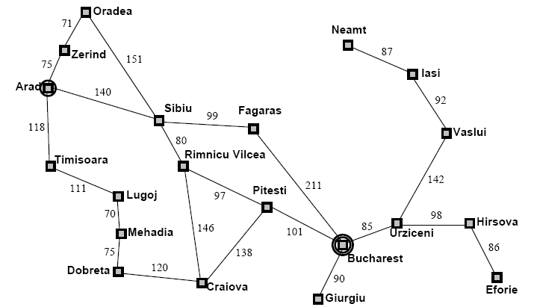
Example: Map Planning

Slide 18
Searching For Solutions
Initial State
e.g. “At Arad”
Successor Function
A set of action state pairs
S(Arad) = {(Arad->Zerind, Zerind), …}
Goal Test
e.g. x = “at Bucharest”
Path Cost
sum of the distances traveled

Slide 19
Searching For Solutions
Having formulated some problems…how do we solve them?
Search through a state space
Use a search tree that is generated with an initial state and successor functions that define the state space

Slide 20
Searching For Solutions
A state is (a representation of) a physical configuration
A node is a data structure constituting part of a search tree
Includes parent, children, depth, path cost
States do not have children, depth, or path cost
The EXPAND function creates new nodes, filling in the various fields and using the SUCCESSOR function of the problem to create the corresponding states

Slide 21
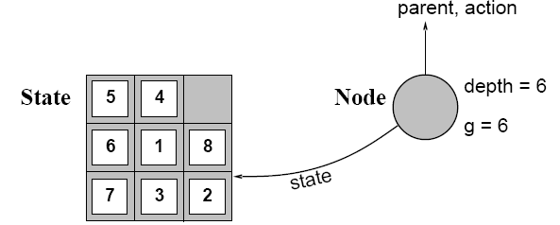
Searching For Solutions

Slide 22
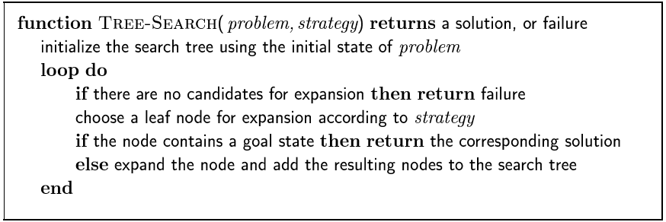
Searching For Solutions

Slide 23
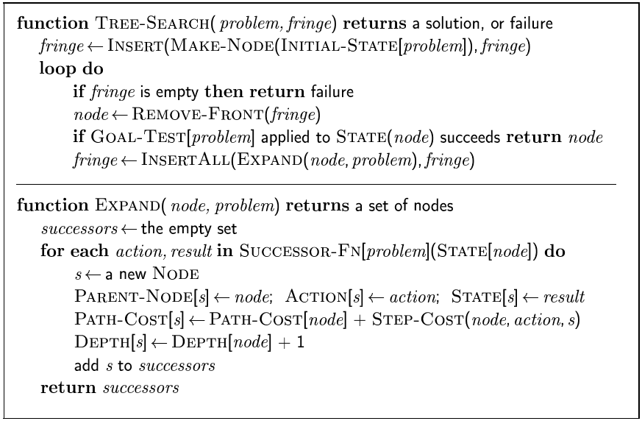
Searching For Solutions

Slide 24
Uninformed Search Strategies
Uninformed strategies use only the information available in the problem definition
Also known as blind searching
Breadth-first search
Uniform-cost search
Depth-first search
Depth-limited search
Iterative deepening search

Slide 25
Comparing Uninformed Search Strategies
Completeness
Will a solution always be found if one exists?
Time
How long does it take to find the solution?
Often represented as the number of nodes searched
Space
How much memory is needed to perform the search?
Often represented as the maximum number of nodes stored at once
Optimal
Will the optimal (least cost) solution be found?
Page 81 in AIMA text

Slide 26
Comparing Uninformed Search Strategies
Time and space complexity are measured in
b – maximum branching factor of the search tree
m – maximum depth of the state space
d – depth of the least cost solution

Slide 27
Breadth-First Search
Recall from Data Structures the basic algorithm for a breadth-first search on a graph or tree
Expand the shallowest unexpanded node
Place all new successors at the end of a FIFO queue

Slide 28
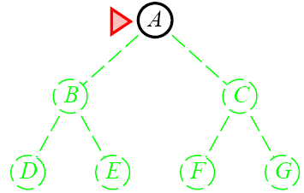
Breadth-First Search

Slide 29
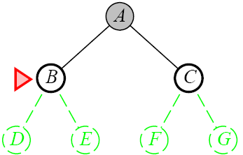
Breadth-First Search

Slide 30
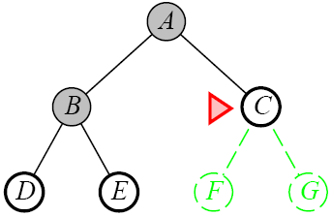
Breadth-First Search

Slide 31
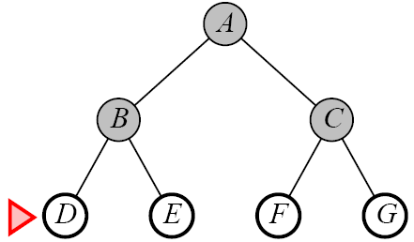
Breadth-First Search

Slide 32
Properties of Breadth-First Search
Complete
Yes if b (max branching factor) is finite
Time
1 + b + b² + … + b^{d} + b(b^{d}-1) = O(b^{d+1})
exponential in d
Space
O(b^{d+1})
Keeps every node in memory
This is the big problem; an agent that generates nodes at 10 MB/sec will produce 860 MB in 24 hours
Optimal
Yes (if cost is 1 per step); not optimal in general

Slide 33
Lessons From Breadth First Search
The memory requirements are a bigger problem for breadth-first search than is execution time
Exponential-complexity search problems cannot be solved by uniformed methods for any but the smallest instances

Slide 34
Uniform-Cost Search
Same idea as the algorithm for breadth-first search…but…
Expand the least-cost unexpanded node
FIFO queue is ordered by cost
Equivalent to regular breadth-first search if all step costs are equal

Slide 35
Uniform-Cost Search
Complete
Yes if the cost is greater than some threshold
step cost >= ε
Time
Complexity cannot be determined easily by d or d
Let C* be the cost of the optimal solution
O(b^{ceil(C*/ ε)})
Space
O(b^{ceil(C*/ ε)})
Optimal
Yes, Nodes are expanded in increasing order

Slide 36
Depth-First Search
Recall from Data Structures the basic algorithm for a depth-first search on a graph or tree
Expand the deepest unexpanded node
Unexplored successors are placed on a stack until fully explored

Slide 37
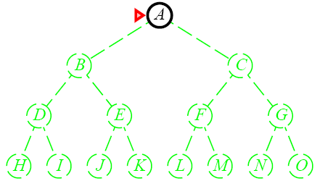
Depth-First Search

Slide 38
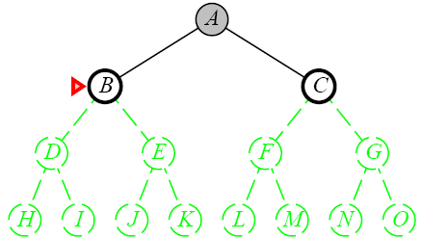
Depth-First Search

Slide 39
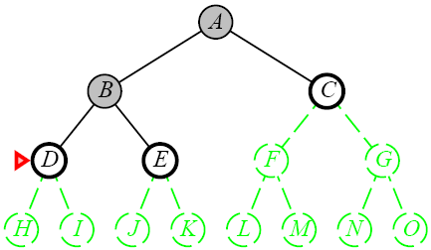
Depth-First Search

Slide 40
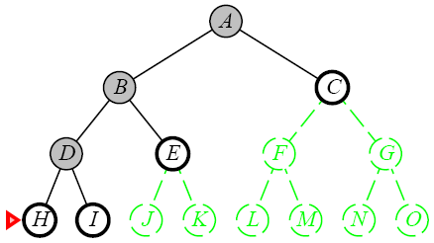
Depth-First Search

Slide 41
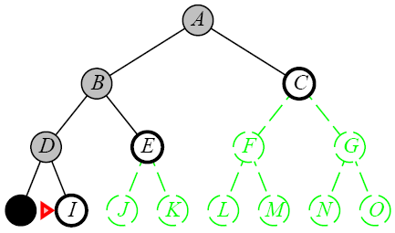
Depth-First Search

Slide 42
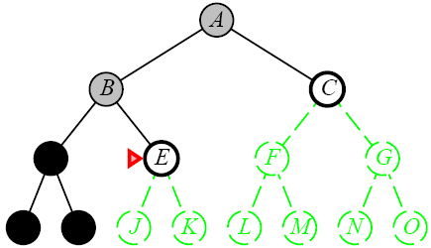
Depth-First Search

Slide 43
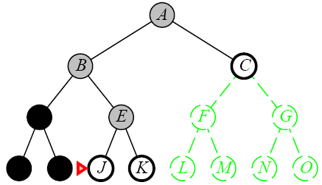
Depth-First Search

Slide 44
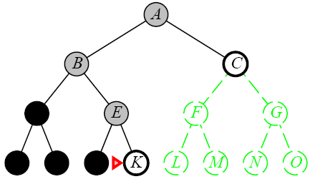
Depth-First Search

Slide 45
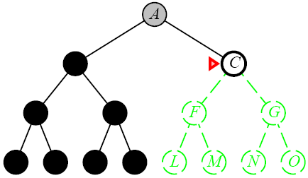
Depth-First Search

Slide 46
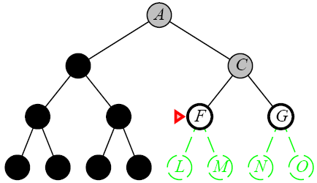
Depth-First Search

Slide 47
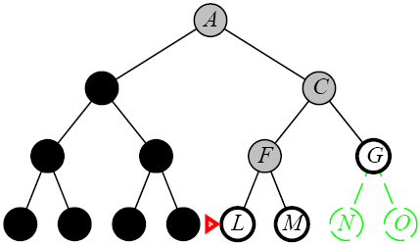
Depth-First Search

Slide 48
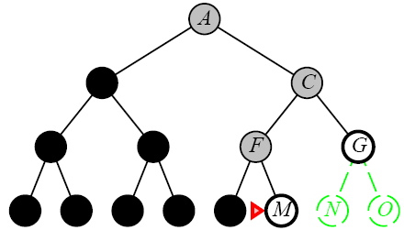
Depth-First Search

Slide 49
Depth-First Search
Complete
No: fails in infinite-depth spaces, spaces with loops
Modify to avoid repeated spaces along path
Yes: in finite spaces
Time
O(b^{m})
Not great if m is much larger than d
But if the solutions are dense, this may be faster than breadth-first search
Space
O(bm)…linear space
Optimal
No

Slide 50
Depth-Limited Search
A variation of depth-first search that uses a depth limit
Alleviates the problem of unbounded trees
Search to a predetermined depth l (“ell”)
Nodes at depth l have no successors
Same as depth-first search if l = ∞
Can terminate for failure and cutoff

Slide 51
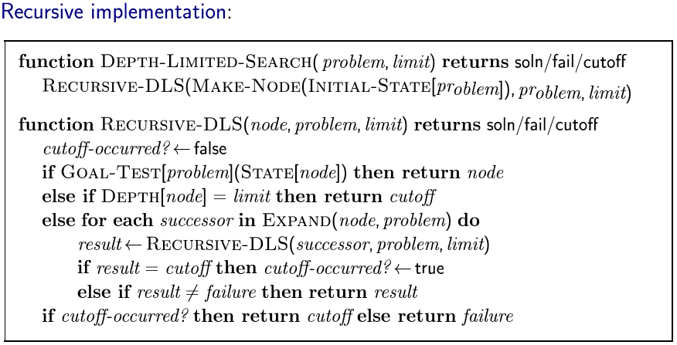
Depth-Limited Search

Slide 52
Depth-Limited Search
Complete
Yes if l < d
Time
O(b^{l})
Space
O(bl)
Optimal
No if l > d

Slide 53
Iterative Deepening Search
Iterative deepening depth-first search
Uses depth-first search
Finds the best depth limit
Gradually increases the depth limit; 0, 1, 2, … until a goal is found

Slide 54
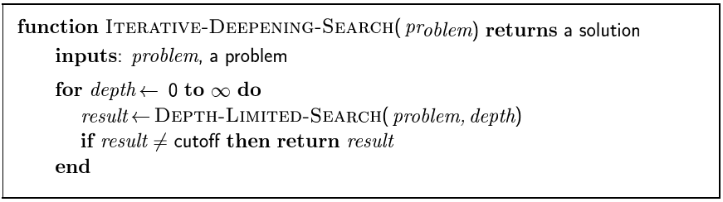
Iterative Deepening Search

Slide 55

Iterative Deepening Search

Slide 56
Iterative Deepening Search

Slide 57
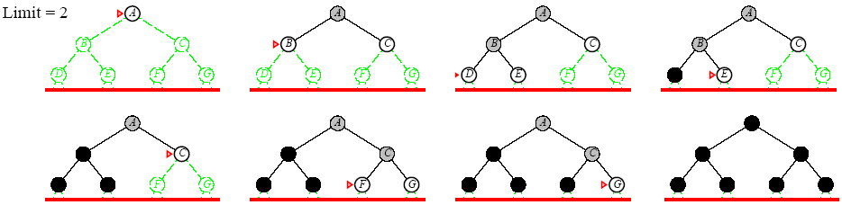
Iterative Deepening Search

Slide 58
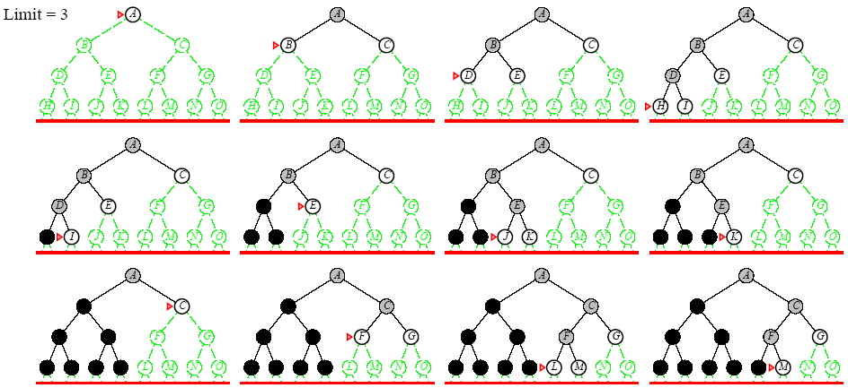
Iterative Deepening Search

Slide 59
Iterative Deepening Search
Complete
Yes
Time
O(b^{d})
Space
O(bd)
Optimal
Yes if step cost = 1
Can be modified to explore uniform cost tree

Slide 60
Lessons From Iterative Deepening Search
Faster than BFS even though IDS generates repeated states
BFS generates nodes up to level d+1
IDS only generates nodes up to level d
In general, iterative deepening search is the preferred uninformed search method when there is a large search space and the depth of the solution is not known

Slide 61
Avoiding Repeated States
Complication of wasting time by expanding states that have already been encountered and expanded before
Failure to detect repeated states can turn a linear problem into an exponential one
Sometimes, repeated states are unavoidable
Problems where the actions are reversable
Route finding
Sliding blocks puzzles

Slide 62
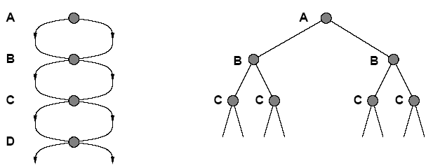
Avoiding Repeated States
State Space
Search Tree

Slide 63
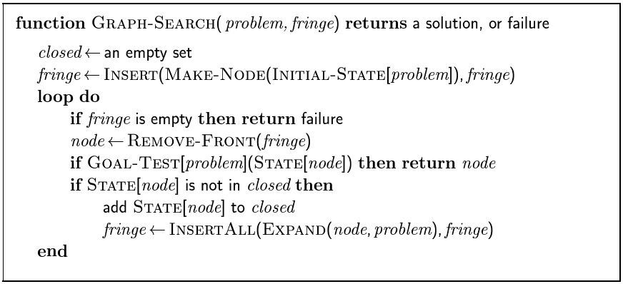
Avoiding Repeated States

